Slide 1


Project Work – Final Defense
On
Clothes Inventory Management System
(CIMS)
Submitted by
Samrajya Pratap Rana(6-2-920-2-2020)
Muna Lama (6-2-920-26-2020)

Slide 2
Presentation Outline
01
02
03
04
05
About Project
Methodology
Introduction, Problem Statement, Objectives
Development Methodology, Requirement analysis
Data Modelling, Process Modelling
Implementation Tools
Tools to develop
the project
Conclusion
Project Demonstration
Conclusion
Development and analysis of a live project.

Slide 3
01
About Project
Introduction, Problem Statement, Objectives

Slide 4
Introduction
Clothes Inventory Management System :
Web-based application for storing clothes inventory.
Features include bulk upload,inventory details and managing stocks.
Enables monitoring of clothing items and inventory levels price and such.
Enhances inventory management and business operations.

Slide 5

Problem Statement
Inefficient inventory management :
01
Inefficient inventory management results in lost sales opportunities.
Manual data entry errors :
Causes inaccurate inventory levels.

Slide 6
Problem Statement
Lack of real-time data :
02
Old system lacks real time data.
Inadequate and mismanaged stocks information:
Timeliness issues with stock information updates.

Slide 7
Objective
Accurate inventory tracking
Customer management
The system shall accurately track inventory levels to ensure enough inventory to meet demand while avoiding excess.
The system shall manage customer information in an effective way as to increase customer loyalty.

Slide 8
Objective
Reporting and analytics
The system shall provide reports on inventory levels, and stock information to help make data-driven decisions and optimize operations.

Slide 9
02
Methodology
Development Methodology, Requirement analysis
Data Modelling, Process Modelling

Slide 10
Development Methodology
The Spiral Model has been used in Clothes inventory management system as it is a practical approach for managing the inherent risks in software development while providing flexibility and adaptability throughout the project lifecycle.
- Allows for iterative development with progressive refinement of the product.
- Suitable for projects where requirements are not completely known at the start.
- Incorporates elements of both waterfall and iterative development methodologies.
- Emphasizes risk analysis and flexibility in accommodating changes throughout the project lifecycle.

Slide 11
Requirement Analysis
1. Study of Existing system
- Similar existing systems: Clothing Inventory Management System, Garment
Management System, Textile Inventory Management System.
- Commonly used industry sites: Fashiongo, ApparelMagic, TradeGecko.
- Valuable insights gained by studying these systems for feature inclusion.
- Aim to enhance effectiveness and user-friendliness for target audience.

Slide 12
Requirement Analysis
In this web-based application user should register their email and password
Admin should have login id and keeps all the necessary information which is required for verification.
Admin shall be able to edit the pharmacist details.
User should register and login into the system with correct details.
User shall list their product with product details.
System shall show the updated product details.

Slide 13
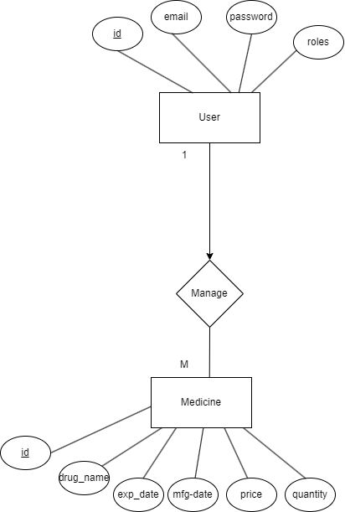
Data Modelling (ER- Diagram)

Slide 14
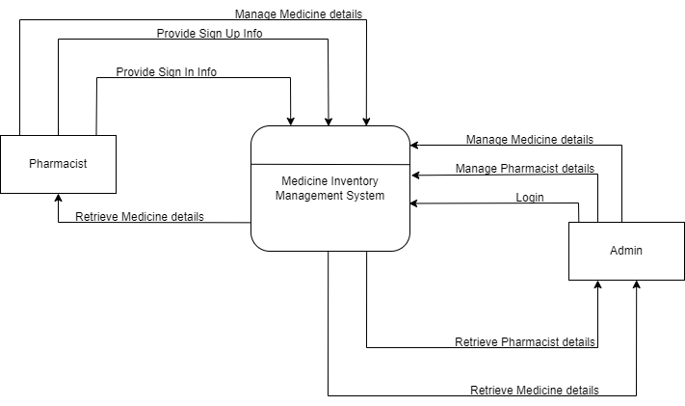
Process modelling (Context Diagram)

Slide 15
Implementation tools
The tools used for the implementation of Clothes Inventory Management
System are listed below:
-Draw.io
-HTML CSS and Java Script
-Node JS
-MySQL
-Visual studio Code
-Xampp

Slide 16
Conclusion
Our system ‘Medicine Inventory Management System’ is a web-based application specifically designed to assist clothing retailers in organizing and monitoring their inventory and stock details. The system is typically equipped with essential features such as inventory tracking, order management, and reporting and analytics which will help users to manage their stock level inventory seamlessly.

Slide 17
Thank You!

